Slide 1
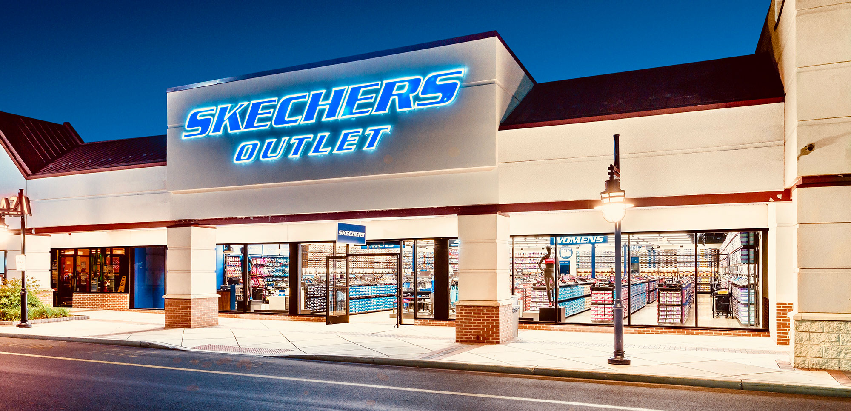
By: Deepika Udhani

Slide 2
Stock Pitch for Skechers
Contents
Company Overview
Corporate Timeline and Key Events
Key Financials
Deriving Intrinsic Value

Slide 3

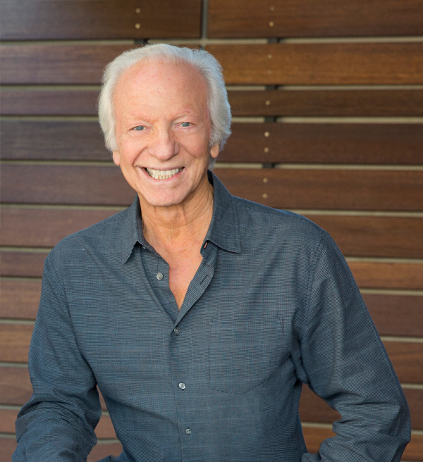
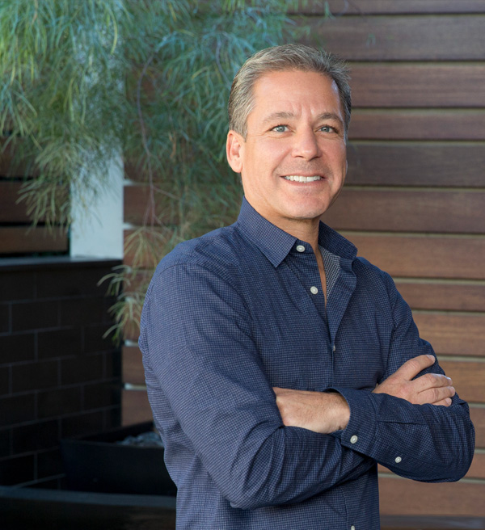
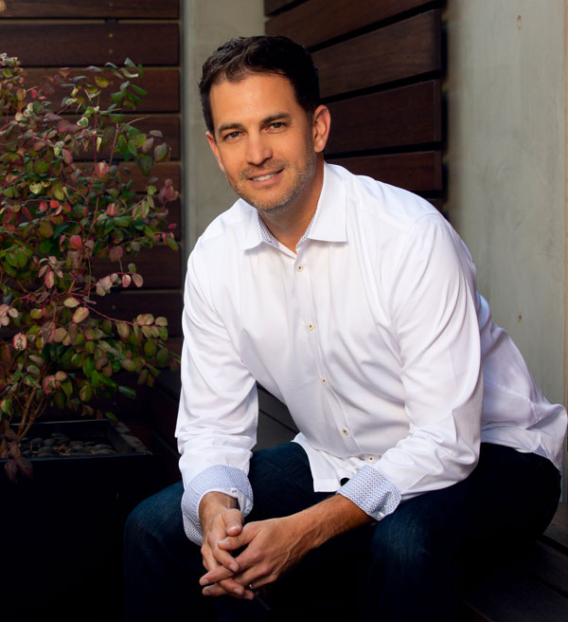
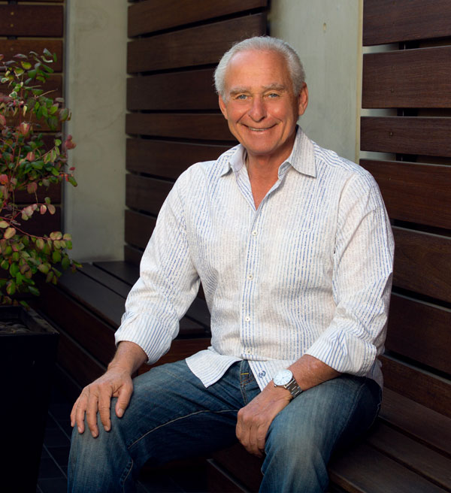
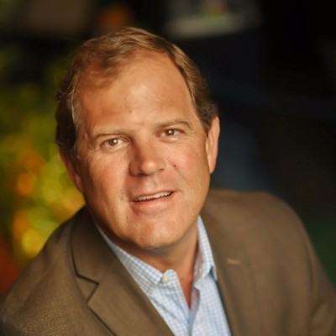
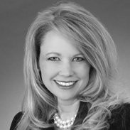
Company Overview
Business Overview
Key Management
Skechers USA, Inc., is a lifestyle footwear company. Founded by Robert Greenberg in 1992, headquartered in Manhattan Beach, USA, Skechers has more than 3,000 retail stores worldwide. Their main focus are shoes which includes various styles for all gender and age. Allied products offered are apparel, bags, eyewear, toys, and more. The company's operating segments include Domestic Wholesale, International Wholesale, and Direct-to-Consumer. Sustainability of the products – that includes a roughly 93% of its shoeboxes are fully recyclable. Skechers’ Key Focus is to become a leading company in the industry by putting people first and offering comfort and care to its employees and customers.
Robert Greenberg
CEO & Founder
Michael Greenberg
President, Co-Founder
Financial Highlights
John Vandemore
CFO
David Weinberg
COO
Skechers has a market cap of $6.14 bn. The current share price is $39.45. Recent acquisitions include Manhattan SKMX, S. de R.L. de C.V., made Skechers Mexico a majority-owned subsidiary of the company. Robert Greenberg, a co-trustee of the Skechers Voting Trust, has sole voting power and owns the company.
Christopher Coye
CIO
Katherine Blair
Director
Source: CIS Market,Statista,Forbes
Notes:
Notes:
Skechers USA Inc is a lifestyle footwear company under the Skechers GO brand name. Products offered include various styles of women's shoes, men's shoes, girl's shoes, boy's shoes, performance shoes, and work shoes. Allied products offered are apparel, bags, eyewear, toys, and more. Its products are available for sale at department and specialty stores, athletic and independent retailers, boutiques, and internet retailers. The company's operating segments include Domestic Wholesale, International Wholesale, and Direct-to-Consumer. It generates maximum revenue from the International Wholesale segment.
Skechers has a market cap of $6.14 bn. The current share price is $39.45. It is using a lot of recyclable materials to increase the sustainability of the products – that includes a roughly 93% of its shoeboxes are fully recyclable.
Skechers’ Key Focus is to become a leading company in the industry by putting people first and offering comfort and care to its employees and customers.
Recent acquisitions include Manhattan SKMX, S. de R.L. de C.V., made Skechers Mexico a majority-owned subsidiary of the company.
Robert Greenberg, a co-trustee of the Skechers Voting Trust, has sole voting power and owns the company.
https://investors.skechers.com/financial-data/all-sec-filings/content/0001193125-16-638585/0001193125-16-638585.pdf
https://en.wikipedia.org/wiki/Skechers

Slide 4
Corporate Timeline and Key Events
Corporate Timeline
Founded in 1992
Footwear
Roller Skates
2014: Athleisure
2022: Asian Expansion
Key Developments
Skechers FY22 Q2 reported $1.9 billion in revenues, exceeding expectations by over $100 million, and growing 12.4% year over year as a result of a 15.4% increase in domestic sales and a 10% increase in international sales. Estimated FY22 year-end revenues are $7.2-7.4 billion, and EPS is $2.60 to $2.70 with one of the fastest growing EPS in the footwear industry Skechers is expanding into utilization of recyclable materials to increase the sustainability of the products, including 93% of shoebox materials being fully recyclable. Skechers announced a plan to move its operations in the Philippines from a third-party distributor, Trendworks International, to Skechers USA Philippines, Inc. Skechers is considering a Hong Kong based IPO expected to raise $1.5 billion to harbor the rapid sales growth in China, which already represents more than 20% of Skechers revenue.
Source: CIS Market,Statista,Reuters,Finbox

Slide 5
Key Financials
Sector Landscape
2017 Sales by Geography
Global market size of $861.5 Billion as of 2022
Expected a domestic market size of $12 Billion by 2022
As of 2015, only 3 percent of shoes and clothes production were produced in the US, 97% were outsourced to developing countries such as China and Vietnam, etc.
In the sector, Nike possesses the highest brand value, a $36.8 Billion by 2020. The next, Luxurious brand Louis Vuitton, has a $32.3 Billion of brand value. Skechers, with a total of $4.8 Billion brand value, is ranked the 29th among the sector.
Industry Outlook
Estimated annual revenue growth of 3.98%
An average of 3.91 turnover rate over a 12-month period
An average labor cost of 20-35% of gross sales of the industry
Profit margin between 4% to 13%, with average net margin below 8%
Short term production growth negatively affected due to the increasing energy price
Key Industry metrics
Ratio ( US listed ) | 2021 | 2020
Avg. P/E | 28.61 | 36.12
Debt-to-Equity | 1.66 | 1.83
ROE (%) | 29.7% | (10.1%)
Source: CIS Market,Statista,Forbes,ET
Notes:
https://www.readyratios.com/sec/industry/56/
https://www.globenewswire.com/news-release/2022/04/08/2419041/0/en/Global-Custom-Apparel-Market-Size-2022-2025-Overview-Market-Segment-Geographic-Landscape-Key-Players-Opportunities-Challenges-Drivers-Trends-Shares-Revenue-Sales-Price.html

Slide 6
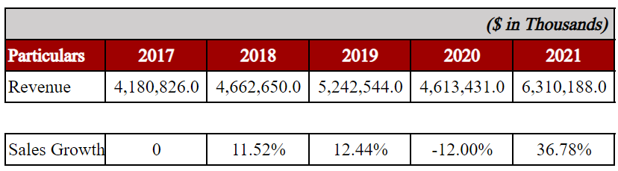
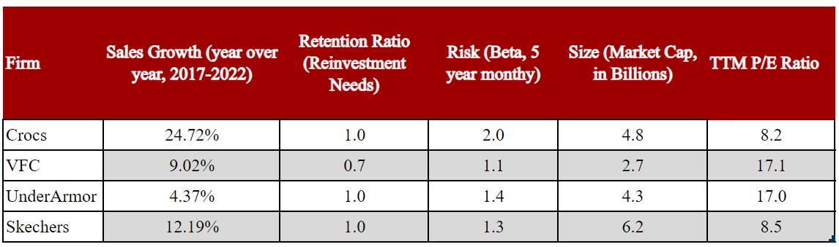
Initial Steps of the Model
Sales Growth Rate
Expected Sales Growth
Comparable Firms

Slide 7
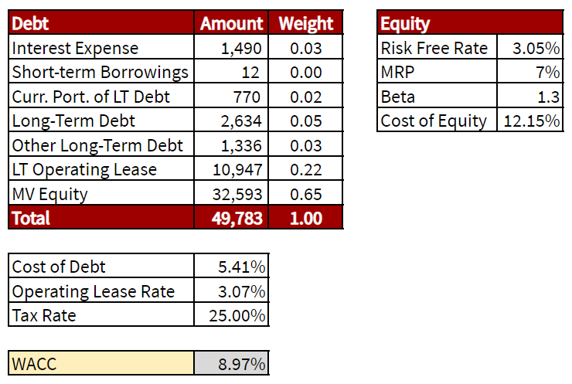
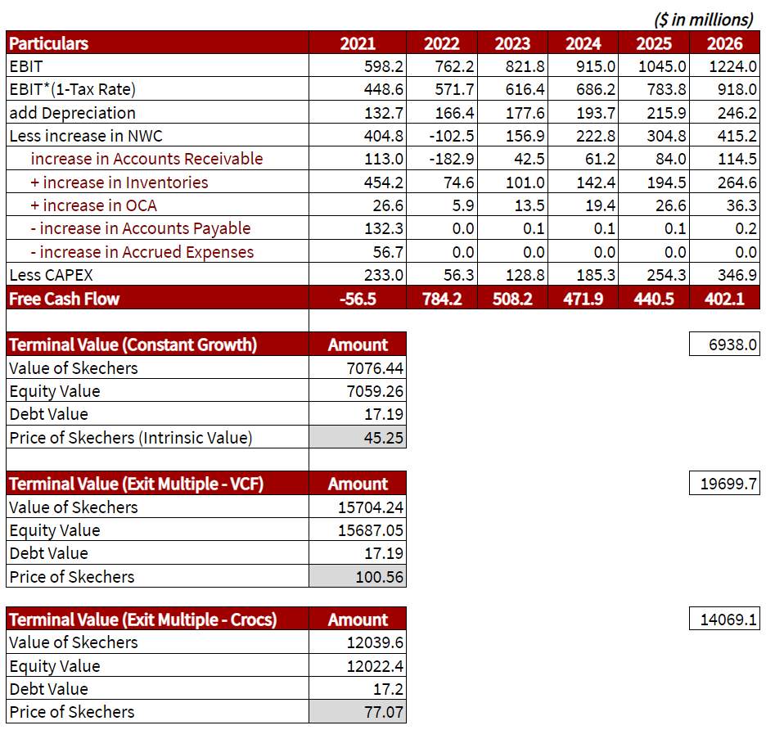
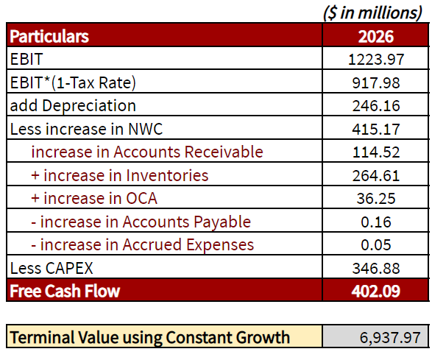
Deriving Skechers' Intrinsic Price
Estimating WACC
Skechers' Intrinsic Price Using Constant Growth
Estimating TV

Slide 8
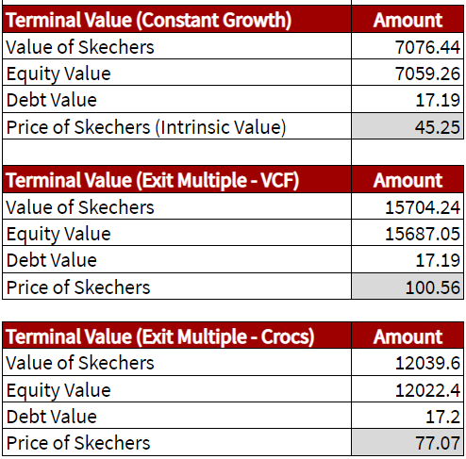
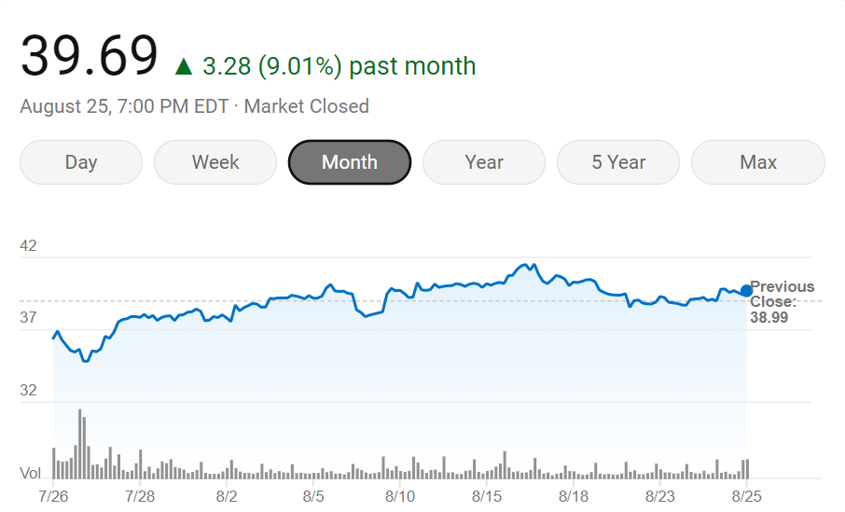
Official Recommendation
Official Recommendation
We recommend a Strong Buy on Skechers stock

Slide 9
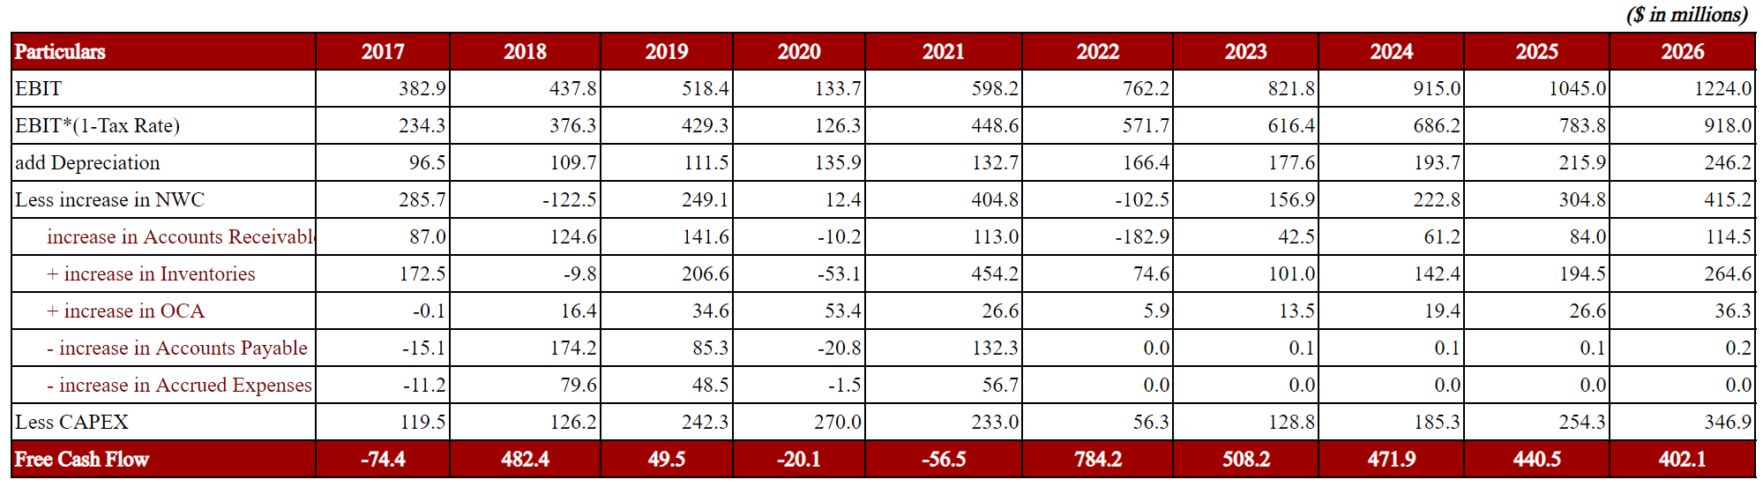
Appendix
FCF Projections (2017-2026)

Slide 10
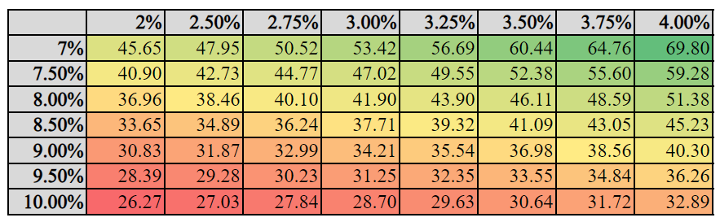
Appendix

